Slide 1
OGC-Khronos ISG Sprint Demo Event: SimBlocks.io
Jordan Dauble, Owner Glen Johnson, Software

Slide 2
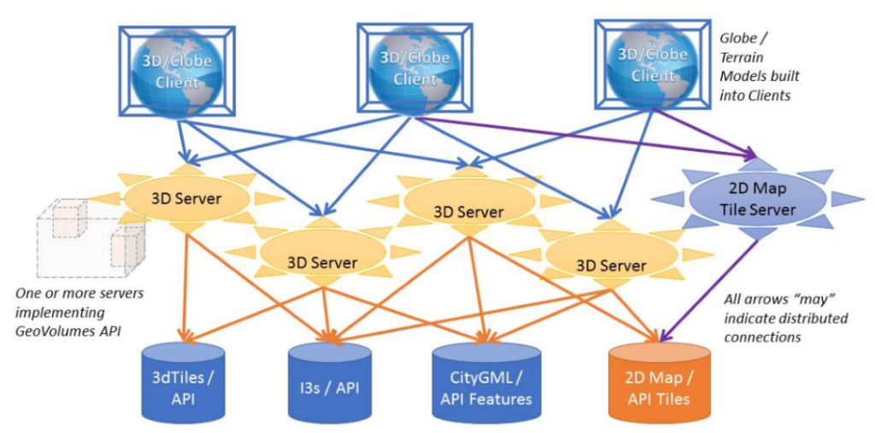
GeoVolumes Architecture

Slide 3
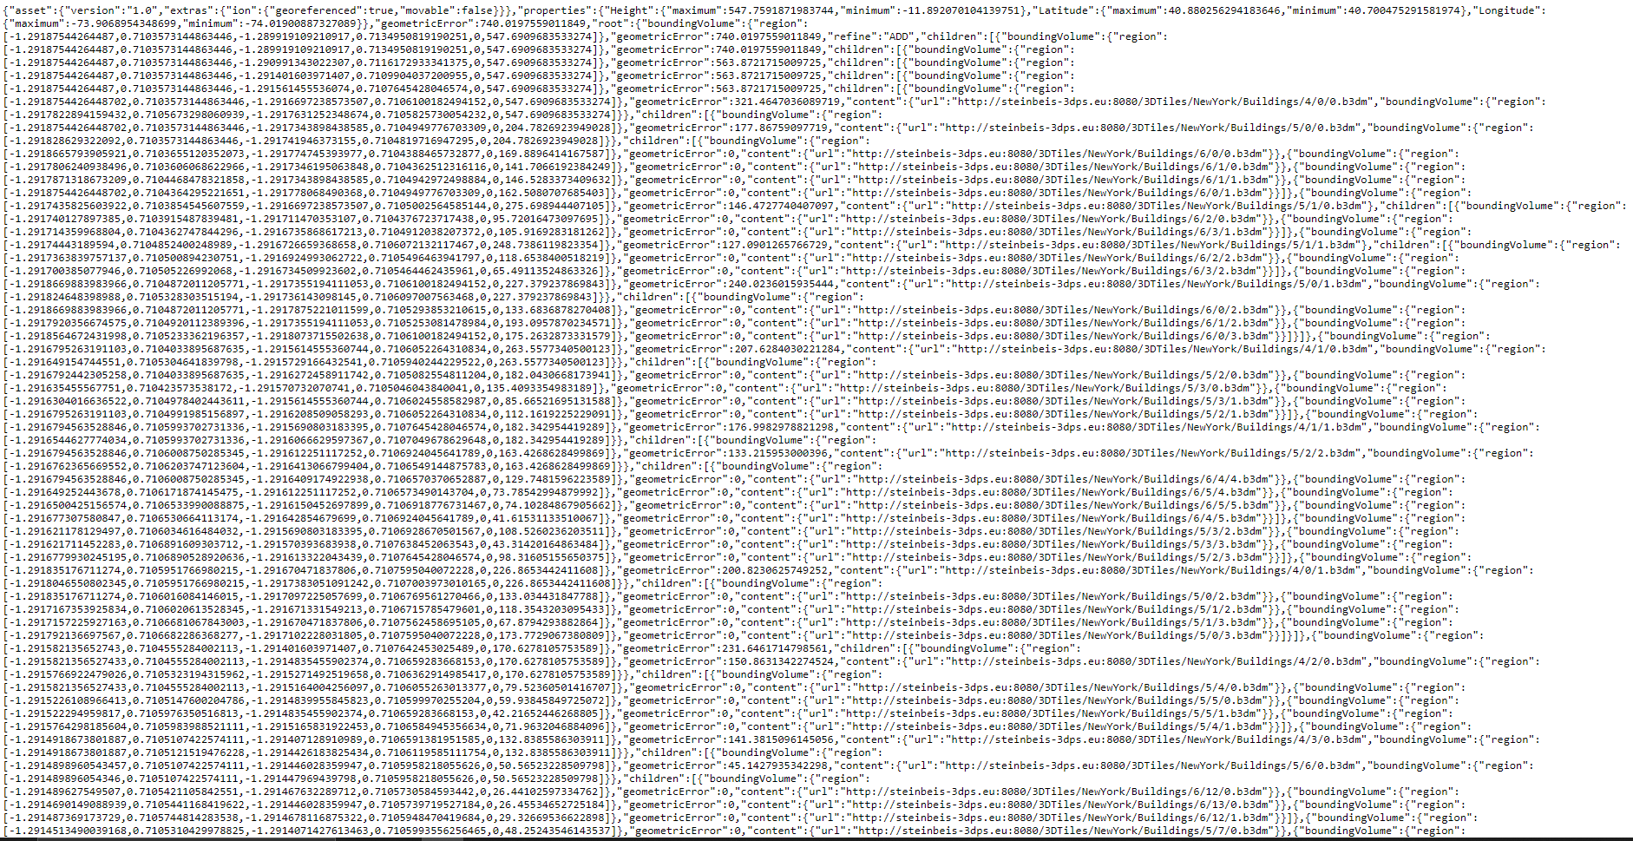
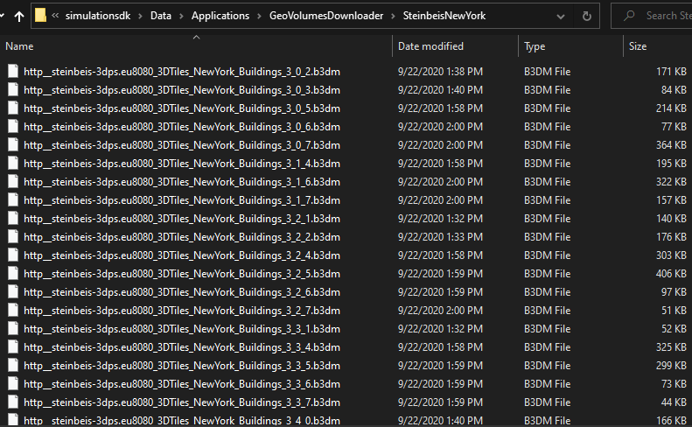
GeoVolumes Connection to Steinbeis Server
.
.

Slide 4
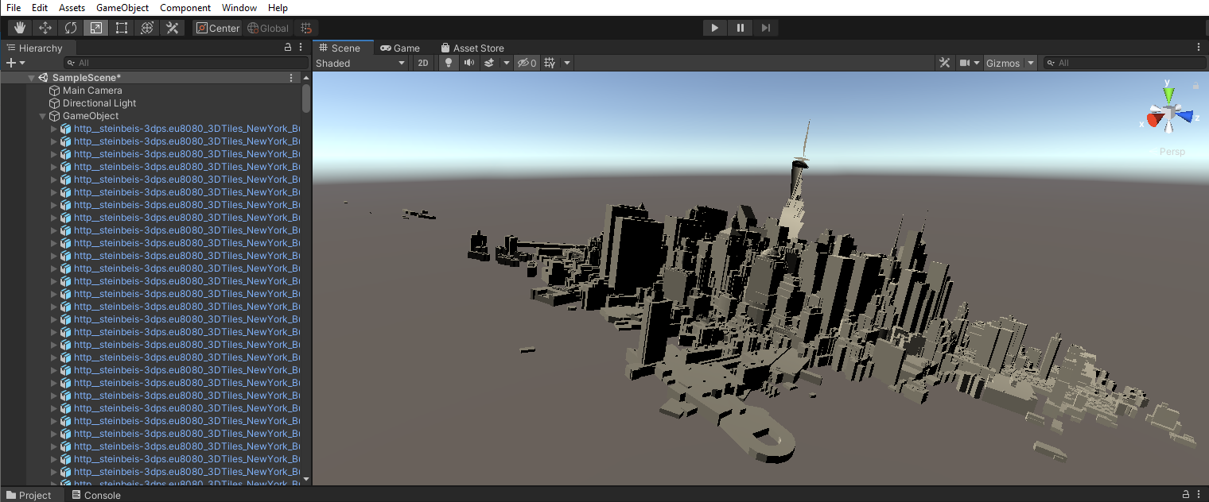
Import into Unity
.
.

Slide 5
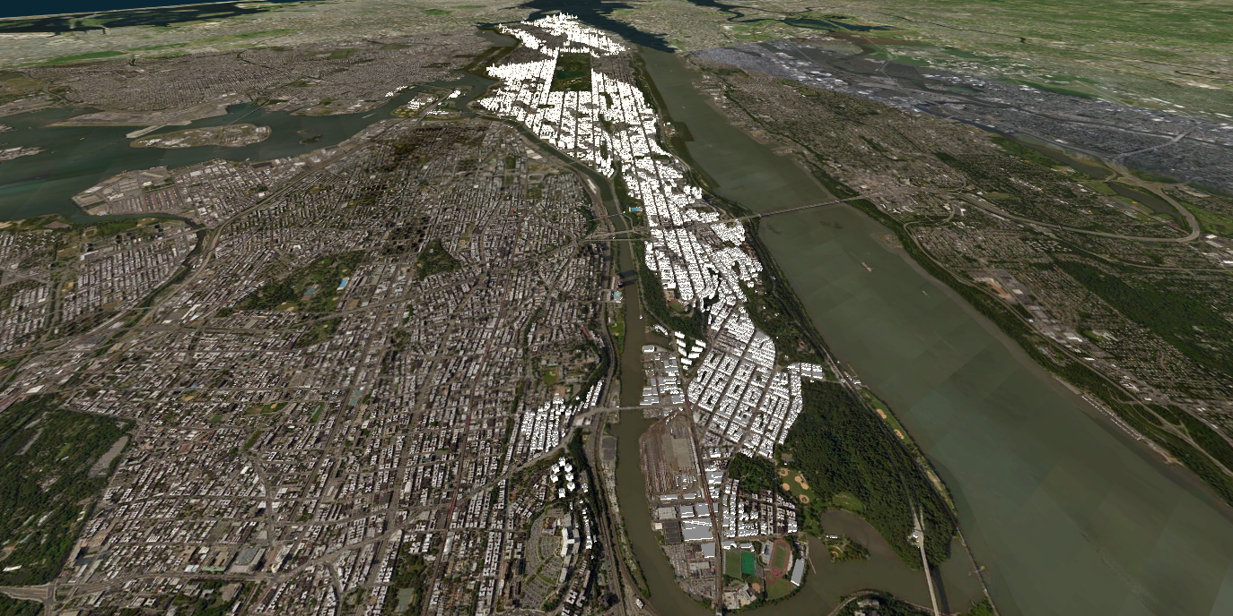
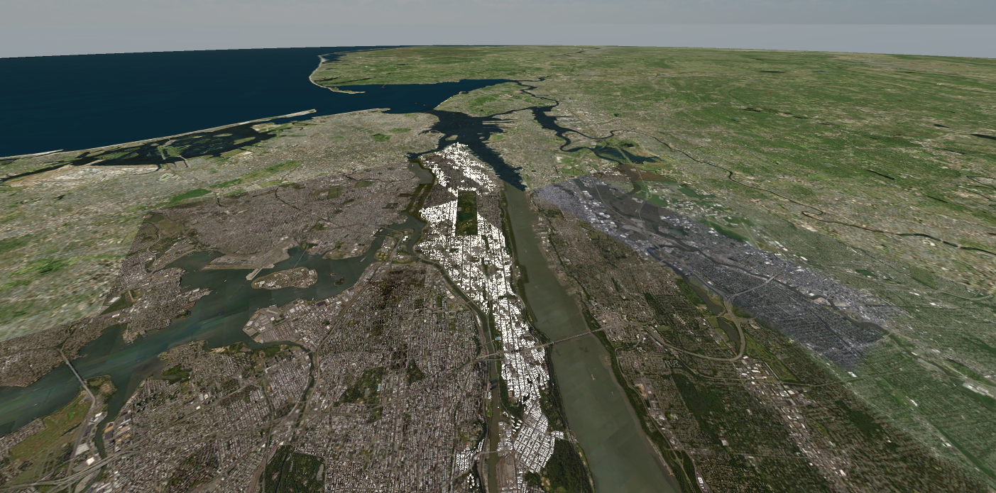
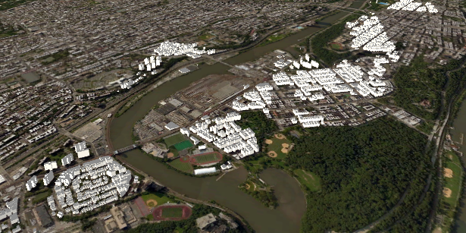
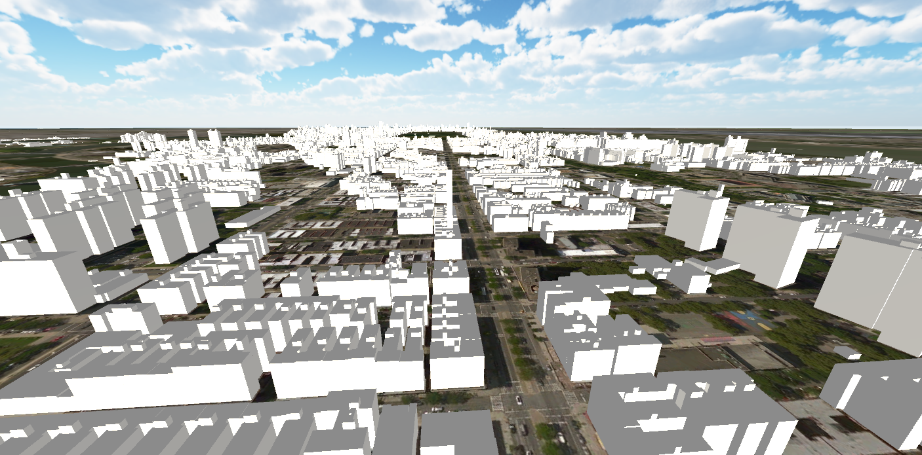
New York 3D Tiles
.Connection to Steinbeis Server
SimBlocks.io Integration with Unity
One World SDK for Unity

Slide 6
VR Screenshots
.
.

Slide 7
San Diego Video
.
.

Slide 8


